Slide 1
Software engineering
Section 3

Slide 2
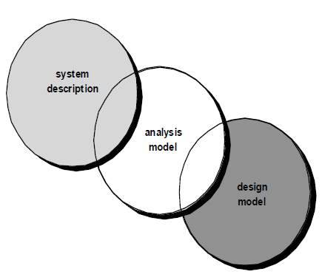

Slide 3
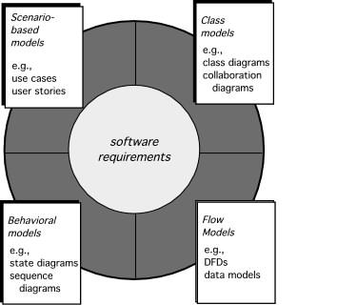
Elements of Requirements Analysis

Slide 4
Scenario-based Model

Slide 5
Scenario-based elements
Functional—processing narratives for software functions
Use-case—descriptions of the interaction between an “actor” and the system

Slide 6
User cases
Use cases describe how a specific user category (called an actor) will interact with the system to accomplish a specific action.
Benefits:
Use cases provide the detail necessary for effective planning and modeling activities.
Use cases help the developer to understand how users perceive their interaction with the system.
Use cases help to compartmentalize software engineering work.
Use cases provide important guidance for those who must test the software.

Slide 7

Actors
An Actor is outside or external the system.
It can be a:
Human
Peripheral device (hardware)
External system or subsystem
Time or time-based event
Represented by stick figure

Slide 8
use case
A use case is a summary of scenarios for a single task or goal.
Represented by an oval

Slide 9
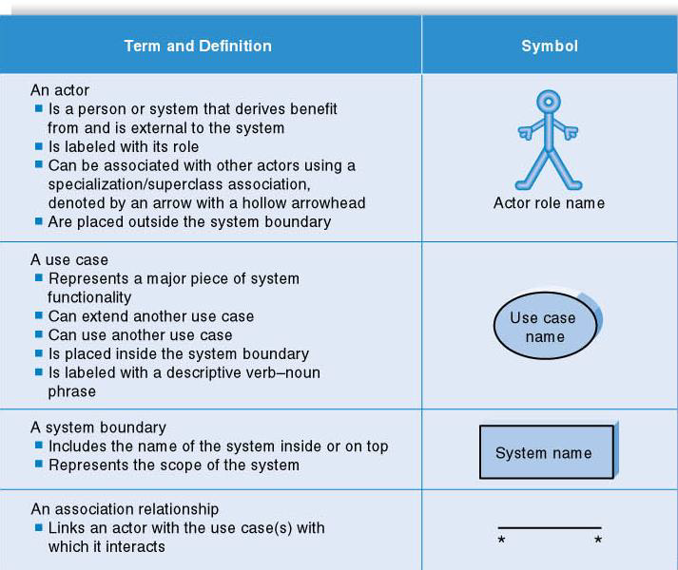

Slide 10
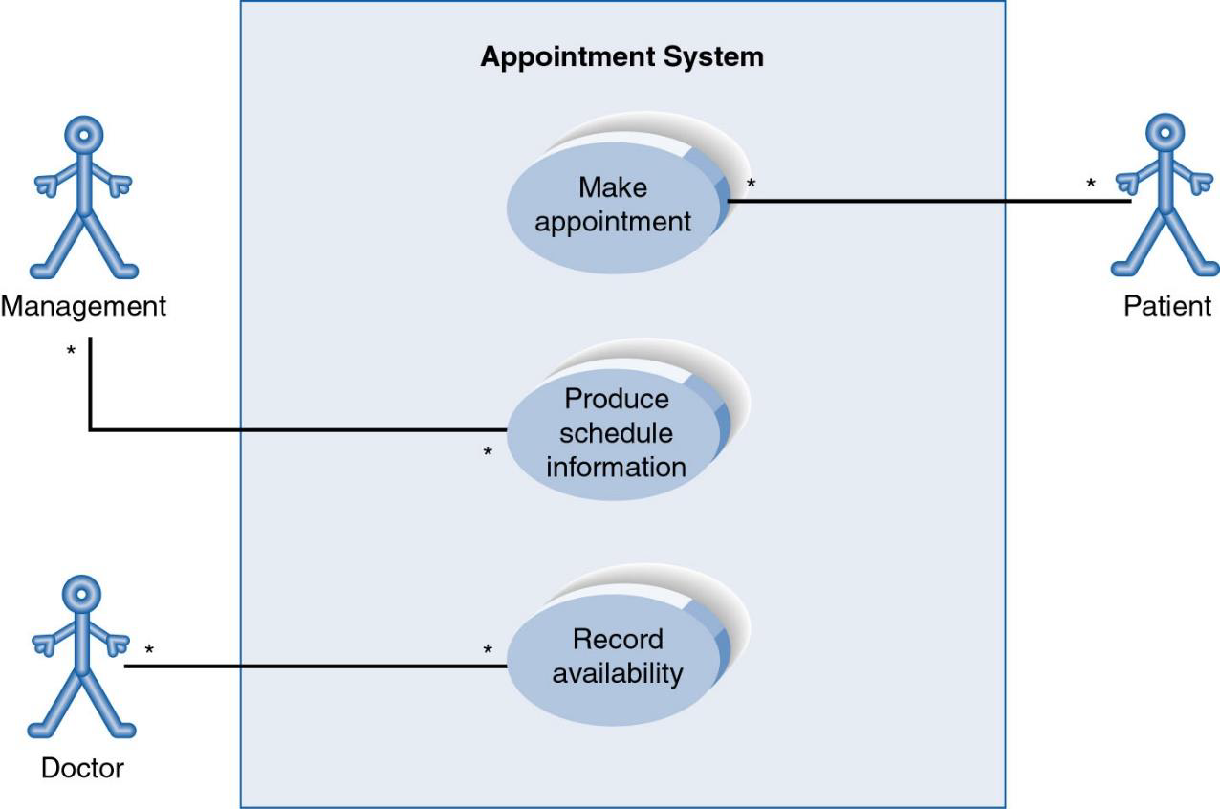
Use-CaseDiagram

Slide 11
Other Types of Relationships for Use Cases
Generalization
Include
Extend

Slide 12
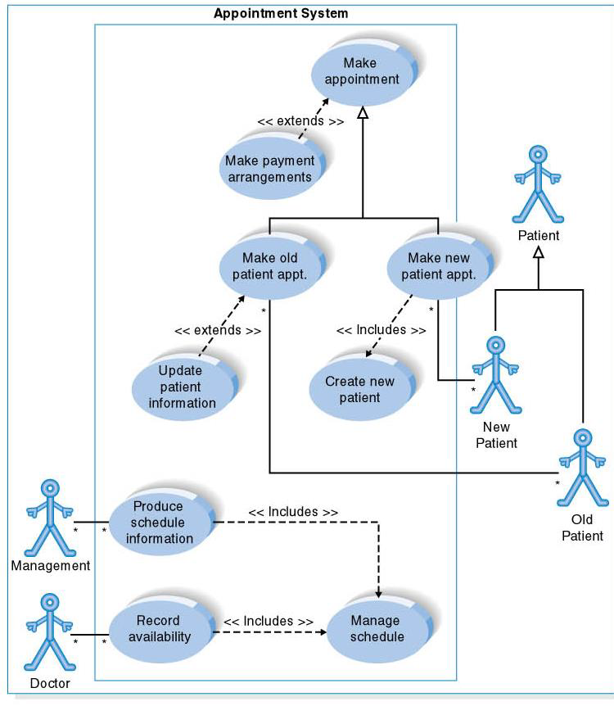

Slide 13
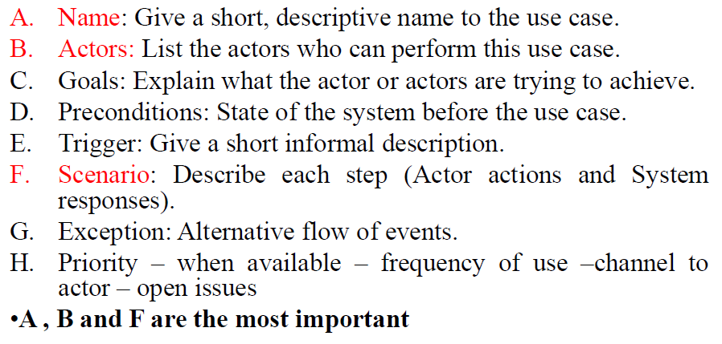
How to describe a single use case

Slide 14
Visual Paradigm

Slide 15
Sheet

Slide 16
Exercise 1
Business actors are Passenger, Tour Guide, Minor (Child), Passenger with Special Needs (e.g. with disabilities), all playing external roles in relation to airport business.
Business use cases are Individual Check-In, Group Check-In (for groups of tourists), Security Screening, etc. - representing business functions or processes taking place in airport and serving the needs of passengers.
Business use cases Baggage Check-in and Baggage Handling extend Check-In use cases, because passenger might have no luggage, so baggage check-in and handling are optional.
Draw use case diagram

Slide 17
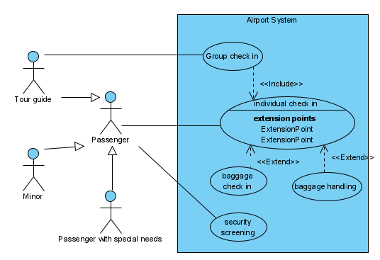
Exercise 1

Slide 18
Exercise 2
Draw use case diagram for Webmail System Use Case Model.

Slide 19
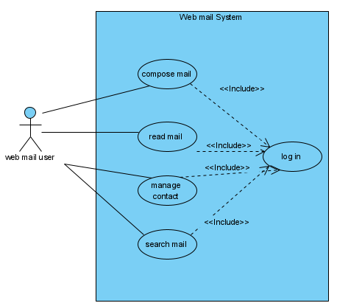
Exercise 2

Slide 20
Exercise 3
Draw the use case diagram and use case table for ‘Login’ to a ‘School Management System’.

Slide 21
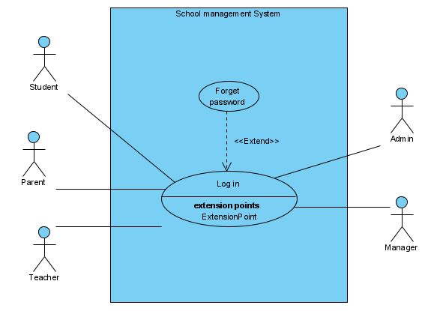
Exercise 3

Slide 22
Exercise 3
Name: | Log in
Actors: | Teacher, parents, admin, student, manager
Goals: | Access the online system
Precondition: | -
Trigger: | Allow the user to access the system from the website using his username and password
Scenario: | Actor Click log in Enter user name and password | System display log in page and ask for username and password Validate Username and Password Allow access to System

Slide 23
Exercise 3
Exception: | Invalid Username: (System shows an error message) Invalid Password: (System shows an error message) Invalid Password for 4 times: (Application closed)
Priority: | Essential, must be implemented
When available: | First increment
Channel to actor: | Via system interface
Frequency of use: | Many times per day
Open issues: | 1.Should there be a way to activate the system without the use of a password? 2.How much time does the user have to enter the password from the time the first key is pressed?

Slide 24
Exercise 3
Name: | Forget password
Actors: | Teacher, parents, admin, student, manager
Goals: | change the user’s password
Precondition: | Log in function
Trigger: | Allow the user to change his password from the website
Scenario: | Actor Click forget password Enter the email Open page via link in email Enter a new password | System display forget password page and ask for the user’s email Send email with link Display message for done the process

Slide 25
Exercise 3
Exception: | Invalid email: (System shows an error message)
Priority: | Essential, must be implemented
When available: | First increment
Channel to actor: | Via system interface
Frequency of use: | 0 or 1 time per day
Open issues: | 1.Should there be a expire time for request change password link in email? 2.How much time does the user have to enter the password from the time the first key is pressed?

Slide 26
Exercise 4
Draw the use case diagram for an ATM, then write use case table for two functions.

Slide 27
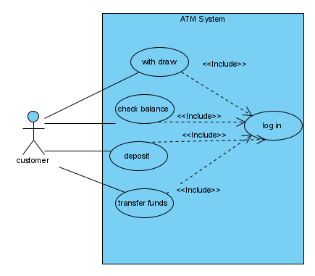
Exercise 4

Slide 28
Exercise 4
Name: | Log in
Actors: | Customer
Goals: | Access the online system
Precondition: | -
Trigger: | Allow the user to access the system using his credit card and password
Scenario: | Actor enter his credit card Enter password | System Read the credit card display log in page and ask for password Validate Password Allow access to System

Slide 29
Exercise 4
Exception: | Invalid Password: (System shows an error message) Invalid Password for 4 times: (Application closed)
Priority: | Essential, must be implemented
When available: | First increment
Channel to actor: | Via system interface
Frequency of use: | Many times per day
Open issues: | 1.Should there be a way to activate the system without the use of a password? 2.How much time does the user have to enter the password from the time the first key is pressed?

Slide 30
Exercise 4
Name: | Check balance
Actors: | Customer
Goals: | display the user’s balance
Precondition: | Log in to the system
Trigger: | Allow the user to display his balance after log in to the system
Scenario: | Actor enter his credit card Enter password Click check balance | System Read the credit card display log in page and ask for password Validate Password Allow access to System and display all functions Display the balance on the screen

Slide 31
Exercise 4
Exception: | Invalid Password: (System shows an error message)
Priority: | Essential, must be implemented
When available: | First increment
Channel to actor: | Via system interface
Frequency of use: | 0 or 1 time per day
Open issues: | 1.How does the system display the balance via screen or paper or both ? 2.How much time does the user have to enter the password from the time the first key is pressed?

Slide 32
Exercise 5
Web Customer actor uses some web site to make purchases online. Top level use cases are View Items, Make Purchase and Client Register. View Items use case could be used by customer as top level use case if customer only wants to find and see some products. This use case could also be used as a part of Make Purchase use case. Client Register use case allows customer to register on the web site, for example to get some coupons or be invited to private sales. Note that, Checkout use case is included use case not available by itself - checkout is part of making purchase. Draw the use case diagram.

Slide 33
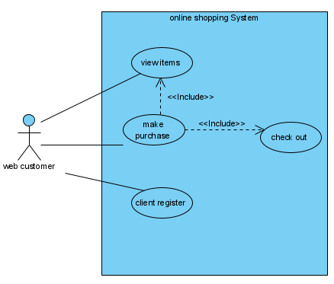
Exercise 5

Slide 34
Exercise 6
A company specializing in consumer electronics requires an order processing system to be developed that is easy-to-use by its employees, and provides a good response time of less than five seconds. Orders are received from customers online who must state the items and expected delivery deadlines. The orders are recorded and prioritized according to stock availability, transport capacity, delivery deadlines, and time of order. The output from the system will be the price of the order, and the delivery date. The customer then has the option to confirm or reject the order. Draw use case diagram

Slide 35
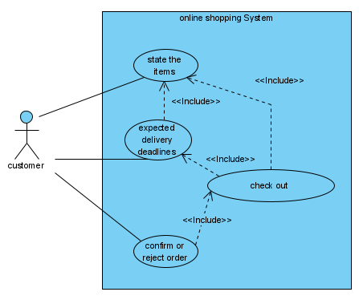
Exercise 6

